Slide 1
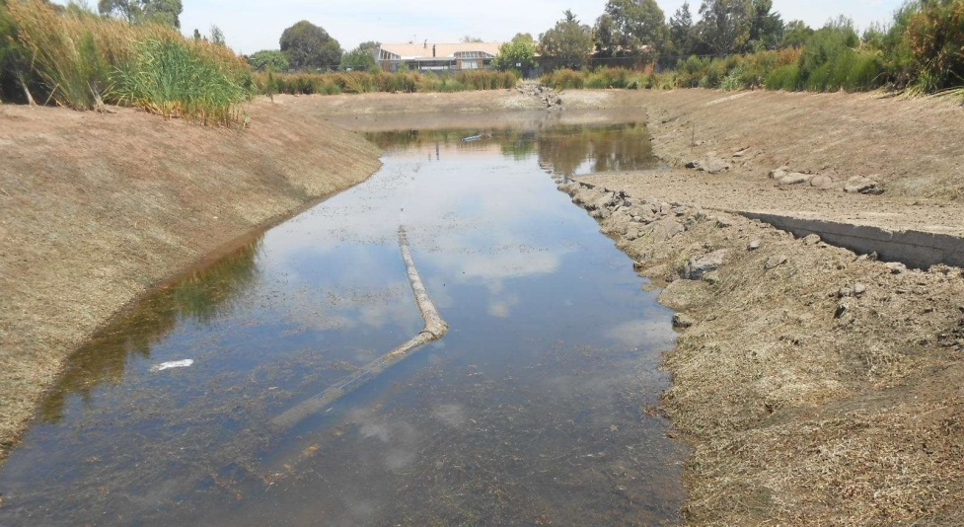
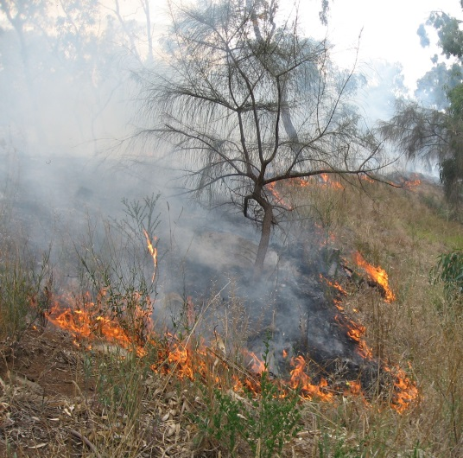
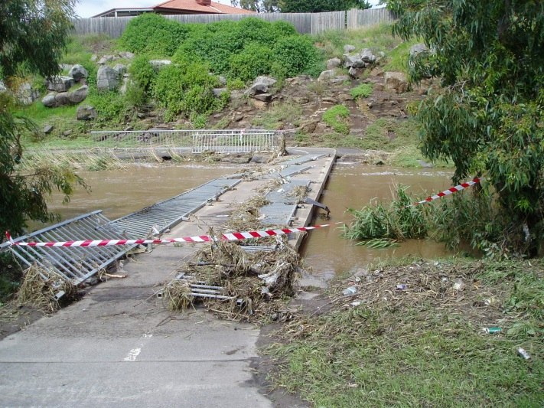
How well are we adapting?
A theoretical framework for monitoring and evaluation of climate change adaptation for local government.

Slide 2
Purpose? Why are we doing this? Many possible reasons…..
To evaluate effectiveness
To assess efficiency
To understand equity
To provide accountability
To assess outcomes
To improve learning
To improve future activities or interventions
To compare with other similar activities or interventions.
(AdaptME Toolkit, 2011)
Notes:
Purpose of M & E is closely related to your objectives:
Why you do something is likely to inform what you want to achieve.
UKCIP list common reasons and state that some of these reasons may be complementary or conflicting but that understanding the synergies and tensions early on helps in developing a balanced and effective approach to M & E.
To evaluate effectiveness: this requires objectives (outputs and outcomes) are specified at the start. Still learning what is effective in CCA.
To assess efficiency: measuring costs benefits and risks and timeliness of actions (ie. Economic evaluations CBA)
To understand equity: relates to equity and justice and uneven impacts of CC, effects of actions of different people and their ability to engage etc
To provide accountability: contractual or procedural requirements, ensure commitments, expectations and standards are met. (may overlap with other purposes ie. Efficiency and effectiveness
To assess outcomes: this can be difficult, attribution of outcomes with interventions, timeframes etc, success can relate to avoiding negative outcomes (ie. Considered as summative evaluation)
To improve learning: core reason for doing M & E, important to think about what this means for this framework and balancing the ‘what happened and why’ (learning) question with the ‘have we done what we said we would’ (accountability) question
To improve future activities or interventions: to inform future projects or mid-way through an ongoing project(ie. Formative evaluation)
To compare with other similar activities or interventions: comparing an intervention in different places or within different communities or comparing implementation and outputs of an intervention with another.

Slide 3
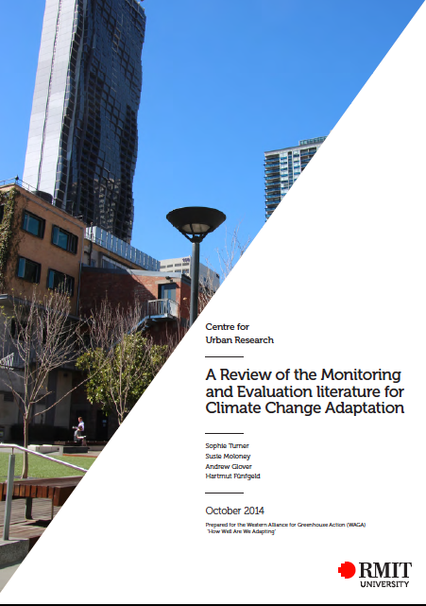
5. Designing a Framework – Approaches and Indicators: Some key lessons from the literature
Many frameworks – few implemented
Purposes for M & E – why?
Many approaches used – process/learning
Many challenges to designing a framework – principles; shifting baselines; indicator selection/data availability; implementation and embedding
Adaptation M & E – not one size fits all; local context/issues important
https://gallery.mailchimp.com/b38874b25e686137780eb836e/files/M_E_Lit_Review.pdf

Slide 4
What are we measuring against?
Against objectives?
Comparing outputs and outcomes against what a program intended
Against ‘good adaptation’ (Principles?)
Defined by guiding principles such as sustainability, collaborative, open, effective, efficient, equitable
ADAPT Principles: Adaptive learning; Dynamic monitoring, Active, Participatory, Thorough (Villeneuva 2011)
Against a baseline
Conditions change, before and after interventions not always adequate
Shifting baselines….
Notes:
UKCIP talk about measuring adaptation performance in three different ways (briefly)
Against objectives: comparing outputs and outcomes against what a program or project intended. (ie. Evaluating changes to behaviours or practices)
Against ‘good adaptation’: this may be defined in terms of a set of guiding principles including Sustainability, Proportionate and Integrated, Collaborative and Open, Effective, Efficient and Equitable (see also pg.28 eg.
ADAPT principles Adaptive learning; Dynamic Monitoring; Active; Participatory; Thorough…..)
Against a baseline: measure against a snapshot of conditions before an intervention as we said earlier this is difficult (changing conditions all the time – shifting baselines etc.

Slide 5
Baselines for 5 areas (World Bank 2010)
Climate data: climate parameters such as temperature, rainfall, humidity, and local habitat parameters such as soil conditions and water salinity
Socio-economic data: Indicators of economic and social well-being in a community, including income, food security, health, and the impact of climate change on these factors
Data on institutional and policy processes: Capacity and existence of appropriate institutions (official or unofficial) and the legal framework (e.g. existence and implementation of climate change policies.)
Ecosystem services: The extent to which ecosystem services are affected by the impacts of climate change
Coping Strategies: What strategies the local population has so far used to cope with climate change variability.
Notes:
Developing these baselines prior to the commencement of CCA interventions is essential to ensure proper M&E of progress.
However, these should also be able to be refined over time.

Slide 6
Choosing Indicators: Issues to consider in dealing with shifting or dynamic baselines
Moving targets and scenarios
Adaptive capacity (AC) and vulnerability (V) are dynamic variables
Use of generic indicators to capture underlying causes of vulnerability while specific indicators can be used to monitor the specific measures undertaken to reduce vulnerability
Evaluation processes snapshot V and AC at the end of a program but this needs to be followed up by constant monitoring over long-term
M & E needs to capture the existence of V and AC and those processes that may effect the distribution of V or how capacity leads to action
Notes:
One of the key challenges facing M & E for CCA is the issue of measuring against a ‘shifting baseline’ which is referred to as the challenge of ‘tracking moving targets’ (2012, p. 17).
Adaptation processes take place against a ‘backdrop of evolving hazards, which may become more frequent, severe and unpredictable’
this makes the application of traditional M & E approaches difficult as these tend to focus on measuring progress against a set of baselines.
Villanueva suggests three approaches:
The need to make a distinction between ‘generic’ and ‘specific’ indicators of vulnerability and adaptive capacity. M&E of adaptation projects may need to capture two types of indicators: those that target the specific measures undertaken to reduce vulnerability to a specific hazard (such as disaster risk reduction programmes), and generic indicators that capture underlying causes of vulnerability (Adger et al., 2004)
Vulnerability and adaptive capacity are dynamic rather than static variables that change over time (Eriksen and Kelly, 2007). Evaluation processes may capture a snapshot of levels of vulnerability and adaptive capacity at the end of a programme intervention, but this needs to be followed up by constant monitoring and long-term evaluation processes.
A distinction needs to be made between indicators that may capture the existence of vulnerability and adaptive capacity and those processes that may have an effect on the distribution of vulnerability or how capacity leads to action (Eriksen and Kelly, 2007). M&E approaches need to capture such nuances.

Slide 7
‘How Well Are We Adapting?’ Reporting to Who and Why? Different audiences, Different objectives
Council objectives
Community objectives
Monitoring:
To inform future decision making and adaptation activities
To improve learning and build capacity
For comparative purposes
Improve awareness:
What is happening
What is council’s responsibility
Assure action is happening
Climate change education
The delivery of actions with concrete outcomes
Building the capacity of the council and community to respond to and manage climate impacts.

Slide 8
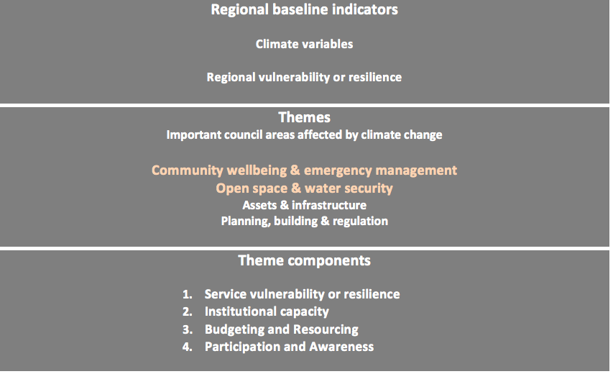
The How Well Are We Adapting framework
Notes:
We have developed a ME framework to track climate impacts on councils’ services and evaluate councils’ response over the long term to understand how well we are adapting.
Regional baselines monitor:
Climate change impacts
Regional population vulnerabilities
Indicators within service areas to assess how councils are responding to these impacts and evaluate their effectiveness.
Two themes:
Open Space and Water Security
Community Wellbeing and Emergency Management.
All WAGA councils are doing a full roll out of the framework and testing it with relevant staff. We will soon review the indicators based on the data collection results.

Slide 9
Project and piloting
Governance and Research
Framework design workshops
Theme indicator development with councils
Piloting and indicator refinement
Project evaluation
Implementing and ongoing reporting
Notes:
Process we undertook with the councils using the lit review to design our framework to our local context?
Lit review, design workshops including practitioners (co-produced),
Pilots / indicator refinement
Choosing levels of indicators – regional and detailed, theme-specific indicators,
Many challenges to designing a framework – principles; shifting baselines; indicator selection/data availability; implementation and embedding

Slide 10
Principles of adaptation
Adaptation implements processes or outcomes that:
Continue to perform under a number of different future scenarios.
Increase flexibility
Build in resilience and/or redundancy
Meet planned budgets
Don’t increase CO2-e
Don’t increase community vulnerability
Avoids adverse outcomes
Notes:
Principles that informed the choice of indicators. (developed overtime through workshops)

Slide 11
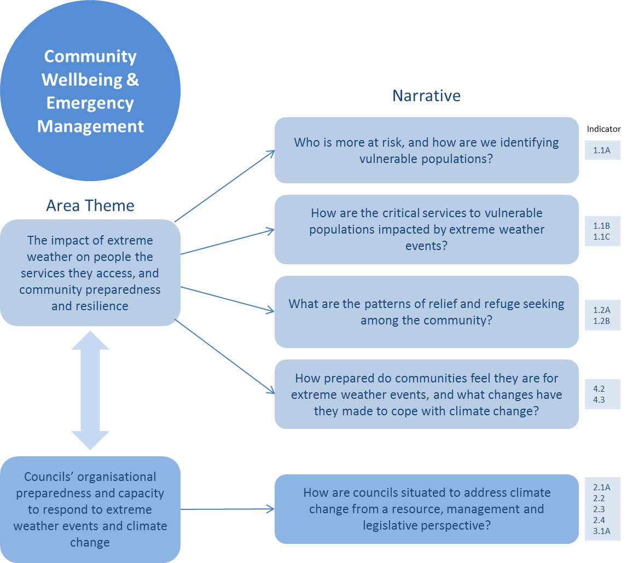
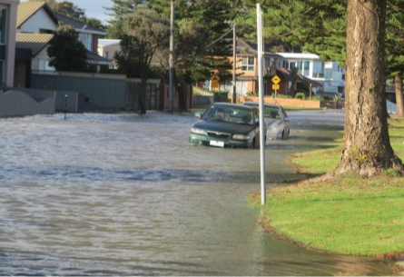
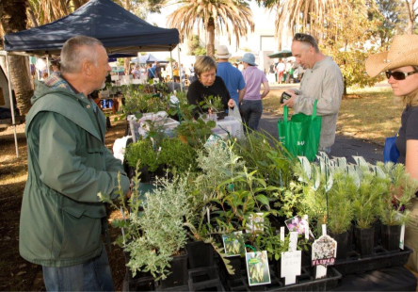
6. Piloting the Framework: Themes and Indicators Community Wellbeing and Emergency management

Slide 12
Community Wellbeing and Emergency Management: Indicators
Service Vulnerability and Resilience:
Knowledge of vulnerable people exposed to extreme weather events
Continuity of critical home and community care services
Residents seeking refuge in official council run emergency relief centres during severe weather events
Institutional capacity:
Staff capacity to address climate change in decision making (interviews and surveys)
Emergency management framework recognises and responds to changing risk levels with climate change
Resourcing and Budgeting:
Tracking long term trends in investment towards preparing for/responding to extreme weather events
Community Participation:
Community preparedness to respond to extreme weather events
Community lifestyle and household resilience to a changing climate.

Slide 13
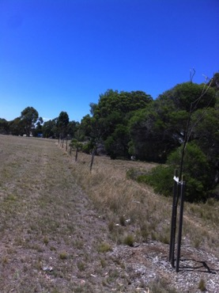
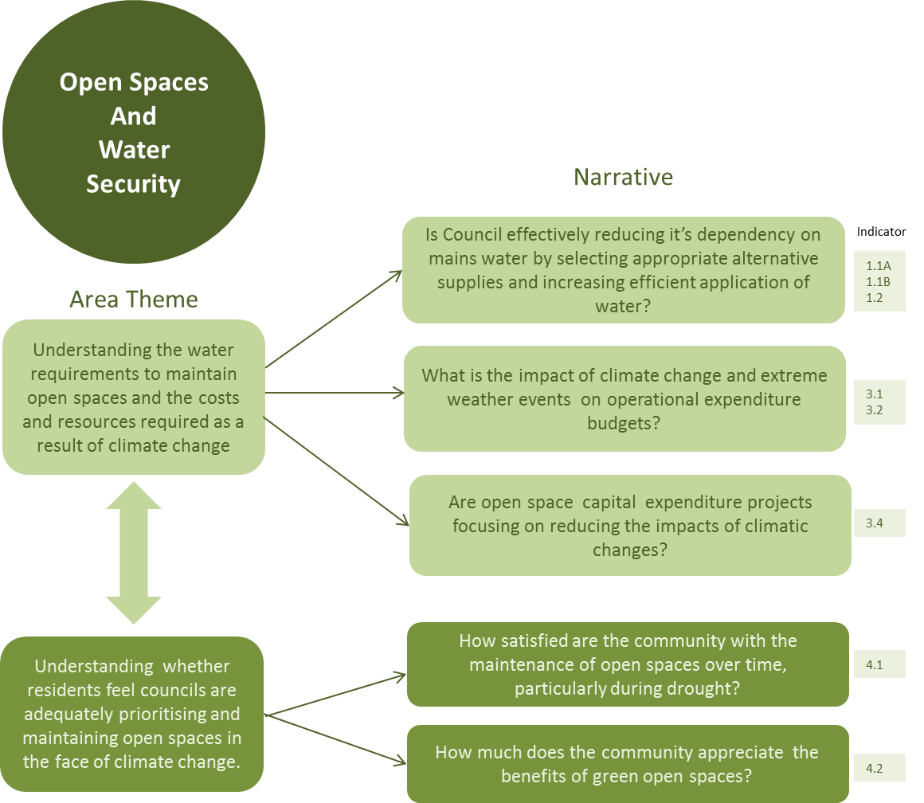
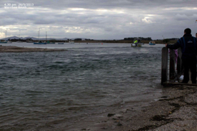
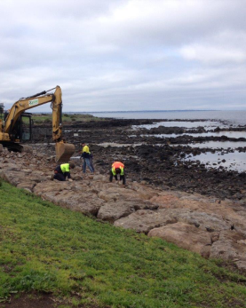
Open Space and Water Security

Slide 14
Open Space and Water Security: Indicators
Service Vulnerability/Resilience:
Type and Volume of water supply used;
variation of gap in water supply compared to demand over time;
water efficiency
Institutional Capacity:
Resourcing:
changes in long term trend in the cost and frequency of extreme weather event cleanups
Understanding the impact of climate change on council’s operational budgets
Participation and Awareness:
Understanding community satisfaction with open space over time

Slide 15
Benefits
Budgeting and resourcing Identifying where councils are absorbing more costs, and why, creating an evidence base.
Being on the front foot
Having meaningful stories to argue a strong case for adaptation support with upper management.
Being prepared for new requirements in an updated Climate Change Act.
Whole of council response
Raising institutional capacity, avoiding adverse outcomes, protecting services to vulnerable residents.
Notes:
Invest in resourcing this data collection and embedding the framework so we have meaningful stories to tell and a strong case to put forward to upper management and State / Fed Govt
Identifying where councils are absorbing more costs and why.
Setting service levels.
Divesting to other departments.

Slide 16
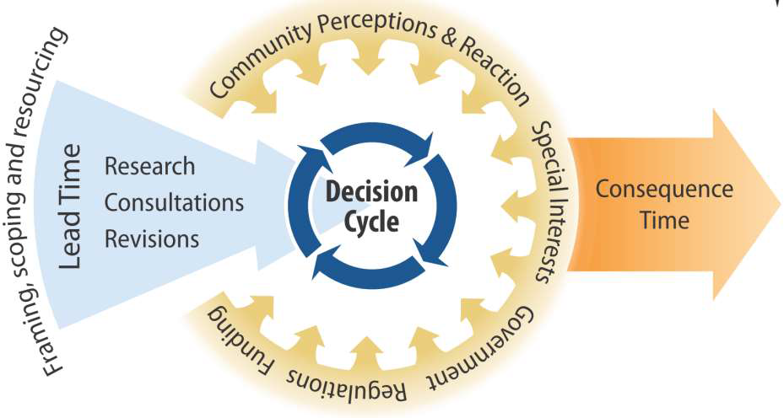
Value of the framework to inform decision making
Notes:
Pervasive impacts have built up gradually across our operations.
Local government decision makers are responding everyday.
It has been challenging to frame the problem and define a response.
It doesn’t even tell half the story of why adaptation is so challenging. To start with, the decision cycle is actually only embedded in a much wider context, where we now know how much framing influences how we even conceptualise the adaptation task at hand. What scoping and resources actually contribute to the range of options, noting that there can also be long lead times before we even reach the decision cycle point? And for some large infrastructure projects, that can run into decades. Think of drainage and housing infrastructure. And a whole range of external influences come to bear on the decision process and risk perceptions – how much is the risk? What’s in it for me? Special interest groups, various levels of government, regulations, and not least, funding.
Lags in the consequence time can range from anywhere between a few years to many decades, even a century when you consider large scale infrastructure.

Slide 17
What could long term trending tell us?
Notes:
Example of what long term trending could tell us in the future.

Slide 18
Key lessons
Embedding happens when the benefits are seen by the people generating the reporting (grounded in the day-to-day)
Embedding happens well when the framework is incorporated with council processes and thereby transcends staff turn-over.
Top down and bottom up process is needed.
Eventual goal is to break down internal barriers and create organisational change – shared responsibility for climate change.
Adaptation M & E – not one size fits all; local context/issues important.
Notes:
There is often a barrier in engaging staff on climate change adaptation because it can be perceived as an abstract concept that will happen sometime in the future, or perceived as being ‘someone else’s problem’. Evaluating and reporting on the indicators in this framework will encourage staff to shift their thinking away from the short term and doing what we’ve always done, towards evaluating how the decisions they make today will affect all of our collective futures, and can improve our resilience overtime.
Indicators can build an evidence base of the impacts and how well we are addressing them over time. In the normal routine of day-to-day decision-making there isn’t often a chance to step back and reflect on what is and isn’t working. This framework intends to act as a feedback mechanism to raise the level of organisational awareness and instil organisational learning and improvement that will push us in the right direction.

